Slide 1


BANKBOT AI – CHATBOT FOR BANKING FAQS
Milestones 1,2,3&4
govindhasatheeshkrishna@gmail.com

Slide 2


AGENDA
1
Introduction: BankBot AI – A Smart Banking Assistant
6
Milestone 2: Advanced Banking Chatbot Assistant
2
Milestone 1: Chatbot UI & Intent Detection
7
Milestone 2: Transaction History & Analytics Dashboard
Milestone 3: Intelligent Chatbot Core & Analytics
Milestone 4:Design and implement secure Admin Login system
Conclusion: Achievements and Future Outlook
3
Milestone 1: Intent Management & Basic Analytics
8
4
Milestone 2: Secure User Authentication
5
Milestone 2: Project Dashboard & Key Capabilities

Slide 3

INTRODUCTION: BANKBOT AI – A SMART BANKING ASSISTANT
AI-powered, secure banking assistant with a conversational interface
AI-Powered Banking Assistant
BankBot AI leverages advanced artificial intelligence and natural language processing to provide users with a seamless and intuitive banking experience, simulating real-world banking operations through conversational interactions.
Secure Authentication and Transaction Handling
The primary goal of BankBot AI is to ensure secure user interactions through robust authentication mechanisms and safe handling of banking transactions, instilling trust in digital banking systems.
Milestones Overview
This presentation covers two significant milestones.
Milestone 1 focuses on establishing core chatbot functionalities.
Milestone 2 emphasizes secure user interactions and the introduction of advanced banking features.

Slide 4
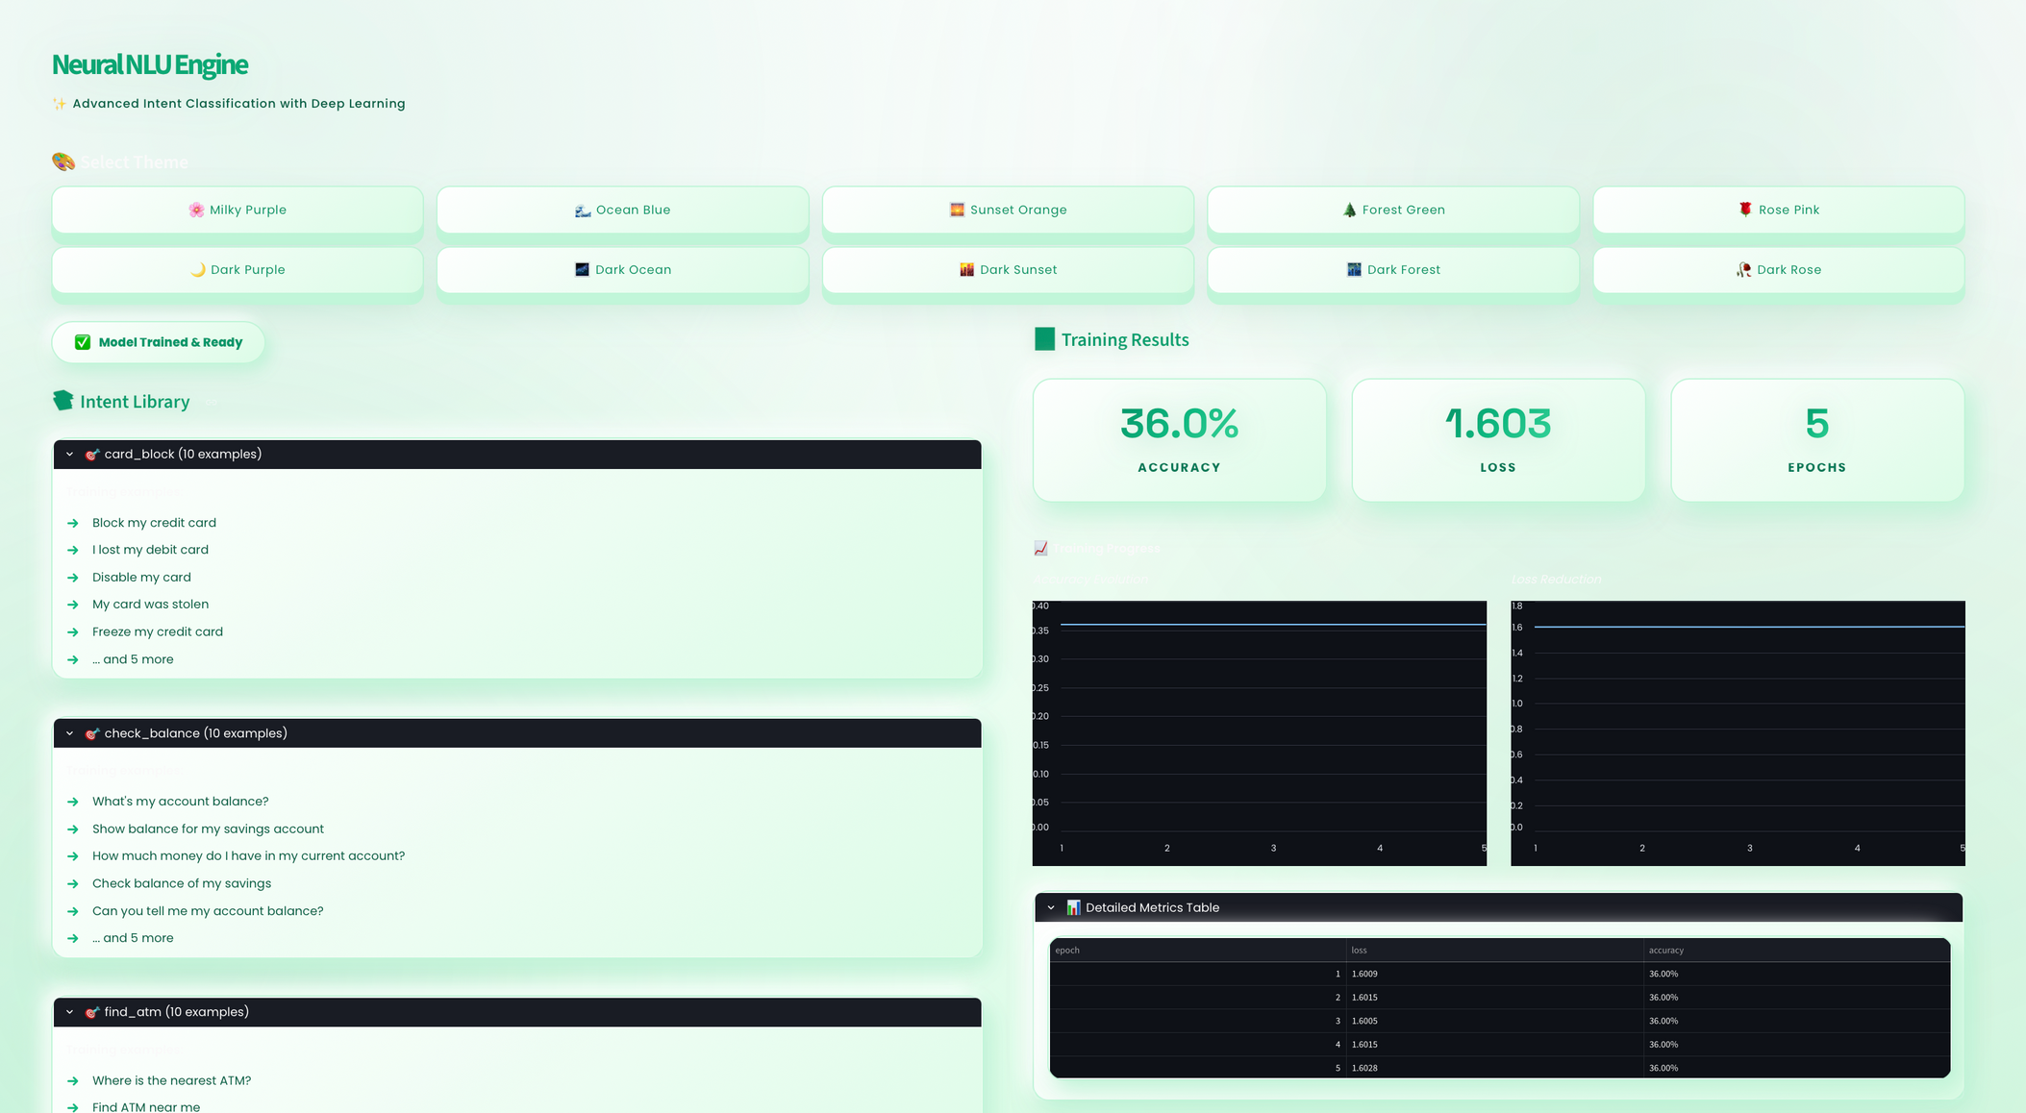
Interface

Slide 5

User-Friendly Chatbot Interface
Built using the Streamlit framework, the chatbot interface allows users to easily input banking queries and receive prompt responses, enhancing user engagement and accessibility
Query History Logging System
The system meticulously logs user queries along with detected intents and confidence scores, enabling continuous monitoring and improvement of chatbot performance.
MILESTONE 1: CHATBOT UI & INTENT DETECTION
Streamlit-based interface for user-friendly banking queries
Intent Detection Functionality
The chatbot accurately interprets user intentions such as transfer_money, check_balance, and change_pin from natural language inputs, ensuring effective communication.

Slide 6
MILESTONE 1: INTENT MANAGEMENT & BASIC ANALYTICS
Managing intents and visualizing user interactions
Intent Manager Overview
Supported Banking Services
Basic Analytics Visualization
The Intent Manager houses a comprehensive list of predefined banking intents, ensuring the chatbot can respond effectively to a wide range of user queries.
Through predefined intents, the chatbot supports banking services such as:
Fund transfers
Balance inquiries
Card management
Account-related actions
Initial analytics provide insights into user interactions, helping identify patterns and trends in banking queries that guide future enhancements.

Slide 7

MILESTONE 2: SECURE USER AUTHENTICATION
USER REGISTRATION PROCESS
Ensuring user account protection and data security
New users can easily create accounts within the BankBot AI ecosystem through a straightforward registration process, improving accessibility and onboarding.
Multi-User Login
A secure multi-user login system protects sensitive user data, ensuring only authorized users can access banking information.
Robust Session Management
Once logged in, users benefit from secure session management, protecting banking access from unauthorized use throughout the session.

Slide 8
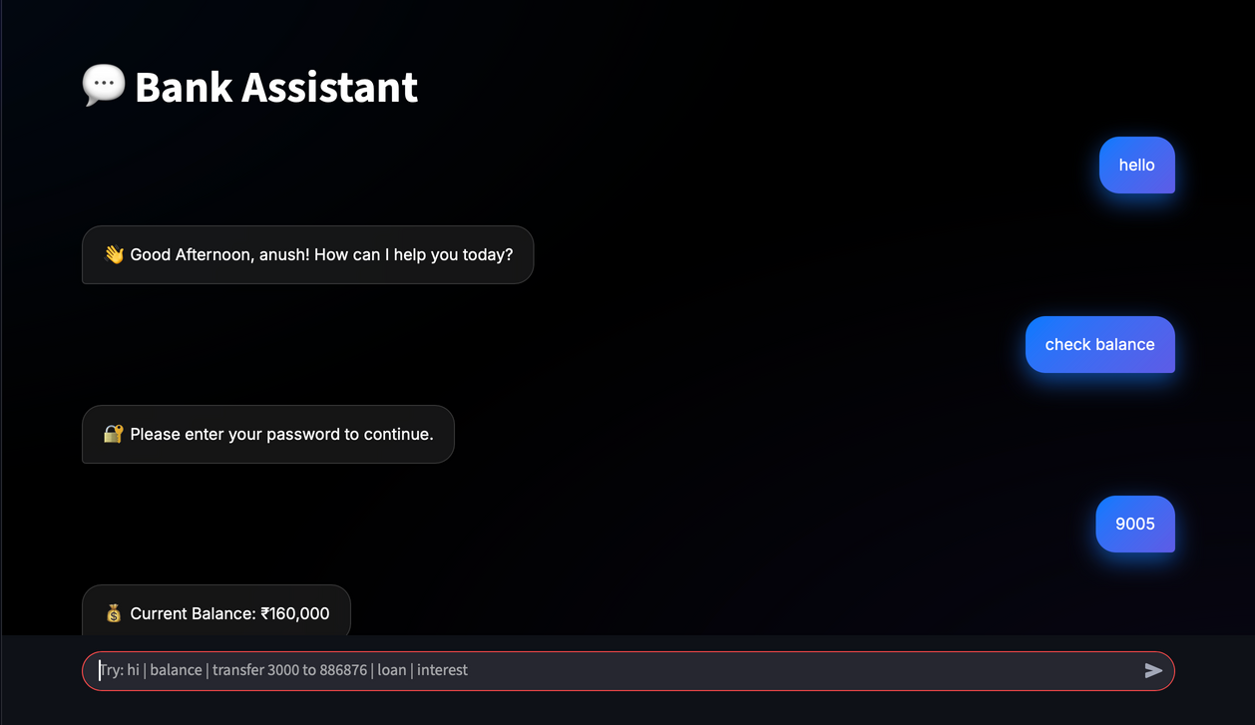
MILESTONE 2: PROJECT DASHBOARD & KEY CAPABILITIES
Central hub for project overview and capabilities
Comprehensive Project Dashboard
The dashboard serves as a central hub providing an overview of the project, objectives, and key capabilities, enabling easy navigation and understanding.
Core Capabilities of BankBot AI
Key capabilities include:
Chatbot-based banking actions
Secure transaction execution
Account management features
Password-protected operations

Slide 9
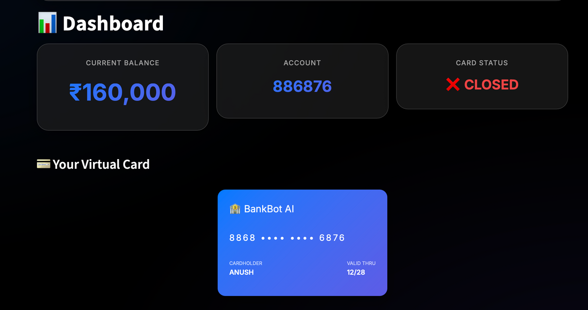
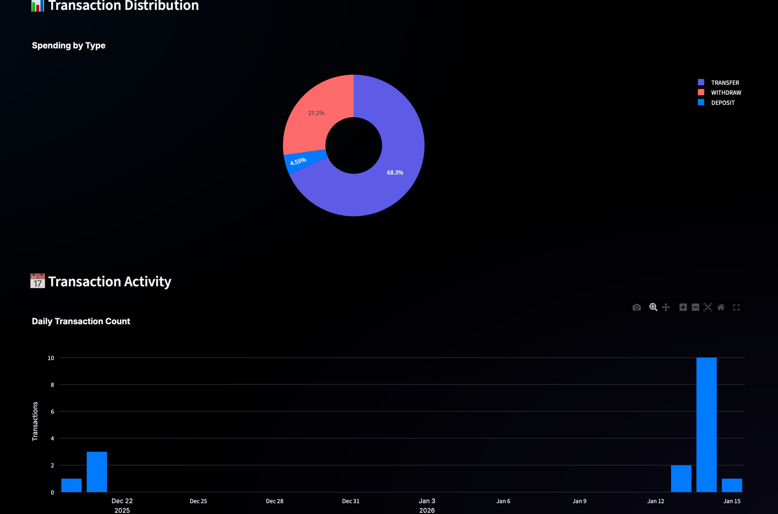
Milestone 2: Advanced Banking Chatbot Assistant
Intelligent Chatbot Functionalities
The chatbot handles a wide range of banking queries efficiently, providing quick and accurate responses to users.
Facilitating Common Banking Operations
Users can perform common operations such as balance checks and fund transfers effortlessly using natural language commands.
Conversational Interface
The conversational interface enables natural interaction, making banking operations more accessible and user-friendly.

Slide 10
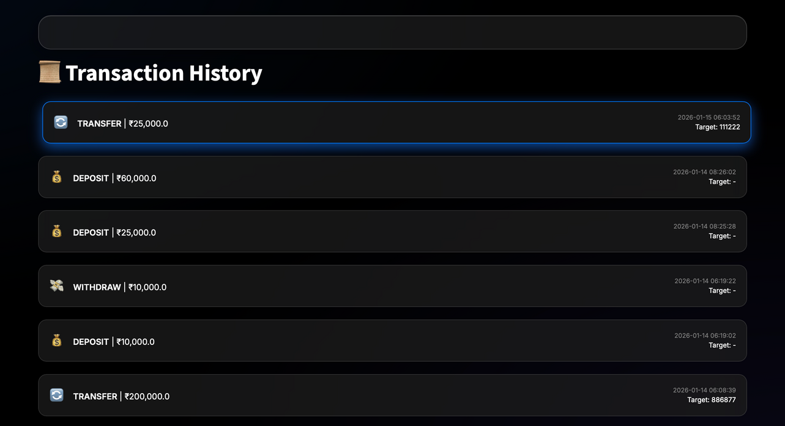
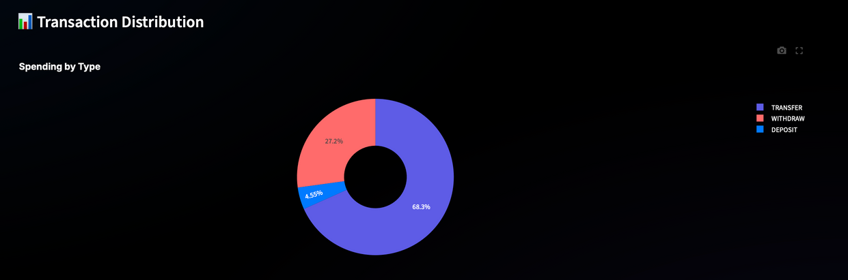
Milestone 2: Transaction History & Analytics Dashboard
Detailed Transaction History
The system provides comprehensive transaction records, including dates, amounts, and target accounts, aiding financial transparency.
Banking Analytics Dashboard
The analytics dashboard summarizes money flow, total transactions, and account activity, helping users understand their financial behavior.
Transaction Distribution Visualization
Graphical visualizations allow users to analyze transaction distribution patterns, improving financial awareness and decision-making.

Slide 11
Conclusion: Achievements and Future Outlook
Both Milestone 1 and Milestone 2 have been successfully implemented, showcasing a functional, intelligent, and secure banking chatbot.
Project Achievements
The project demonstrates:
Secure authentication
Efficient transaction handling
Intent-based chatbot intelligence
Insightful analytics
Future Enhancements and Customer Experience
Future improvements include OTP-based verification, fraud detection alerts, and enhanced analytics, aiming to deliver a more secure and advanced digital banking experience.

Slide 12
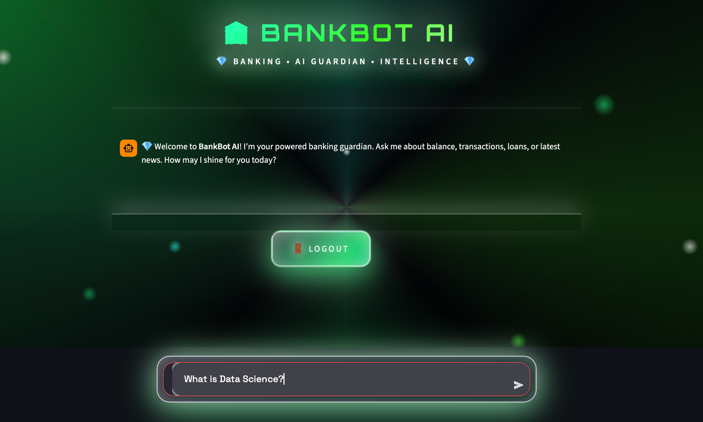
Milestone 3: LLM Integration with Web Search
Goal of This Milestone
Integrate a Large Language Model (LLM) into the chatbot
Enable live web search for real-time information
Maintain existing chatbot stability and UI
Deliver enterprise-grade AI behavior

Slide 13
Why LLM Integration Is Needed
Limitations of Traditional Chatbots
Rule-based systems handle only predefined queries
Static knowledge becomes outdated quickly
Complex natural language queries are hard to interpret
Result: Limited intelligence and poor user experience.
Fetches latest and real-time information
Eliminates dependency on static datasets
Improves accuracy for dynamic queries
Enhances trust in AI responses

Slide 14
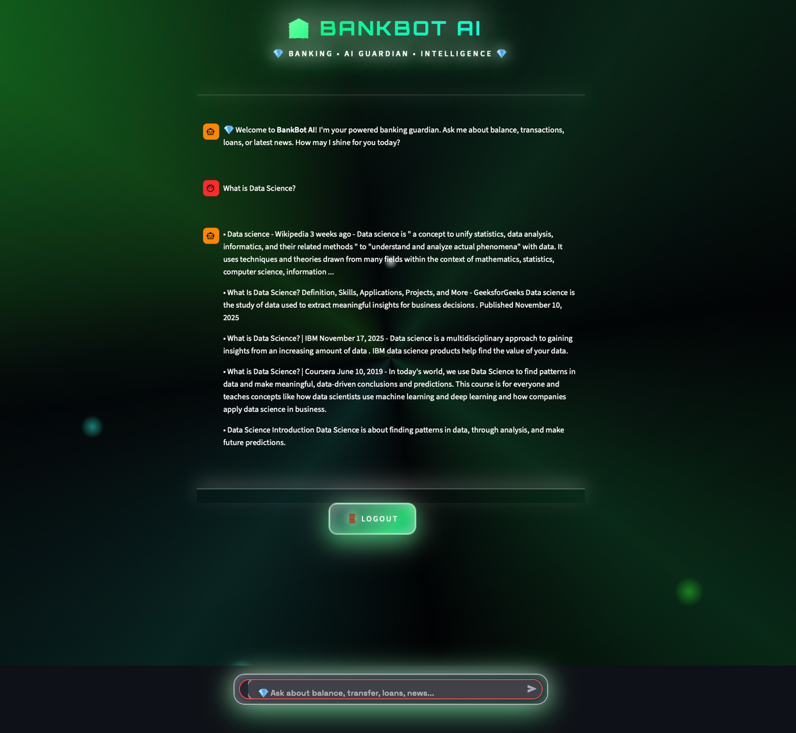
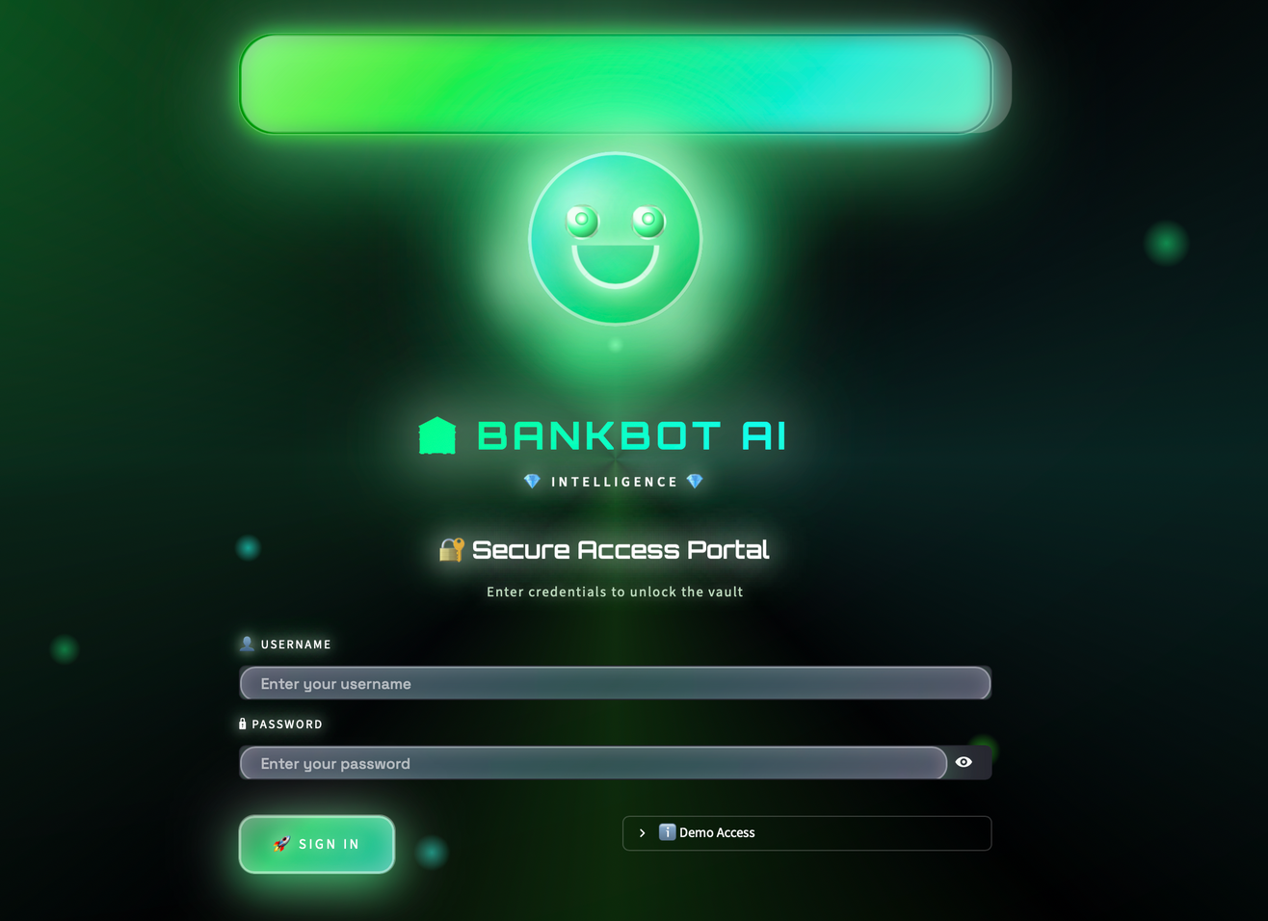
Chatbot Interface

Slide 15
The chatbot uses a hybrid intelligence model:
Rule / intent-based logic first
Confidence evaluation
LLM + web search used as fallback
Clean, summarized response returned to user
This ensures speed, accuracy, and flexibility.
LLM successfully integrated
Web search enabled
Hybrid chatbot architecture implemented
UI and performance preserved
User enters query via chat UI
Dialogue handler evaluates intent
Web search retrieves relevant context
LLM processes query with search context
Final response displayed in chat

Slide 16
Milestone 4
Admin Panel
Objective:
Build a secure Admin Control Panel for managing chatbot intelligence.
Enable real-time monitoring, training data control, and analytics.
Provide a Knowledge Base (FAQs & Q&A) for dynamic updates.
Fully functional admin dashboard with authentication and analytics.
Benefits:
Prevents unauthorized access
Ensures only admins can edit training data and analytics
Improves system security and control

Slide 17
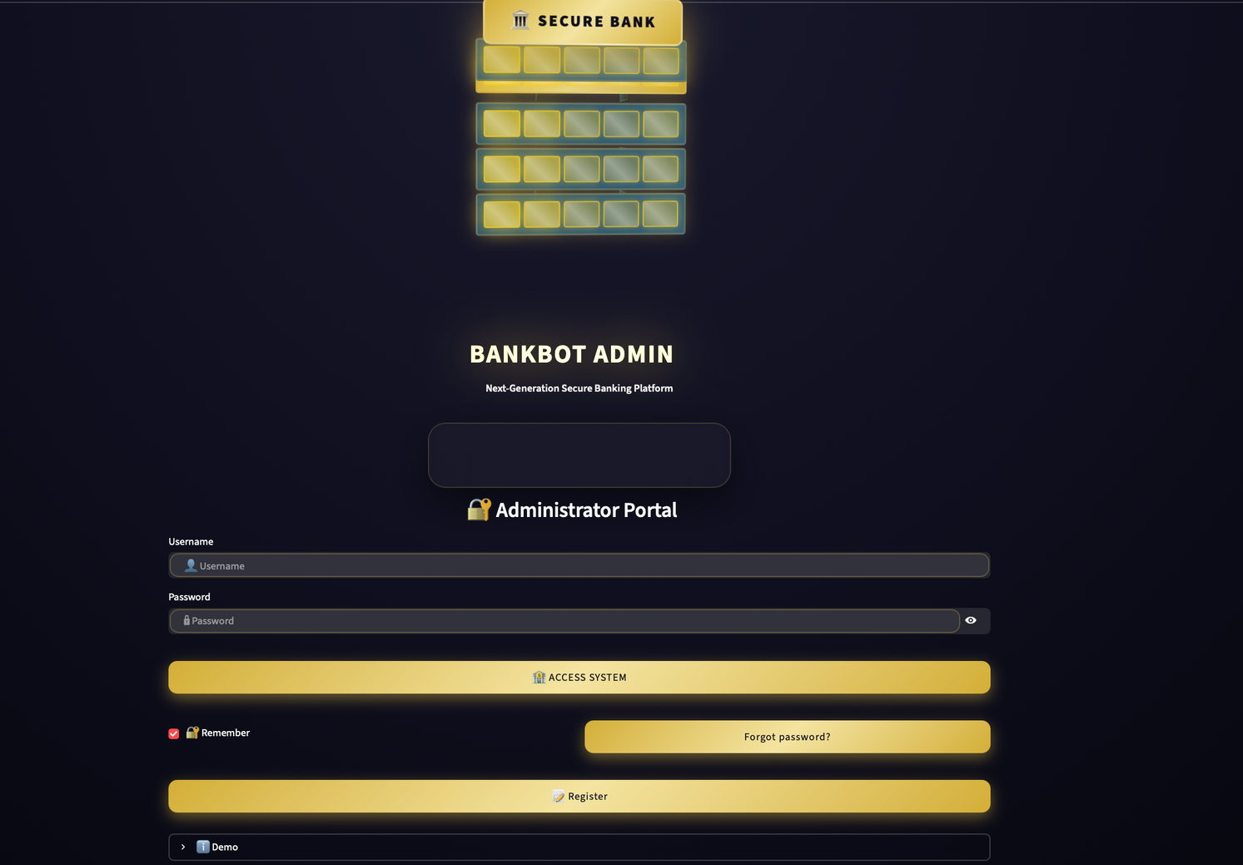
Secure Login & Admin Access
Features Implemented:
Secure Login Page for Admin Users
Credential validation and session-based access
Role-based access to admin functionalities
Logout and session handling

Slide 18
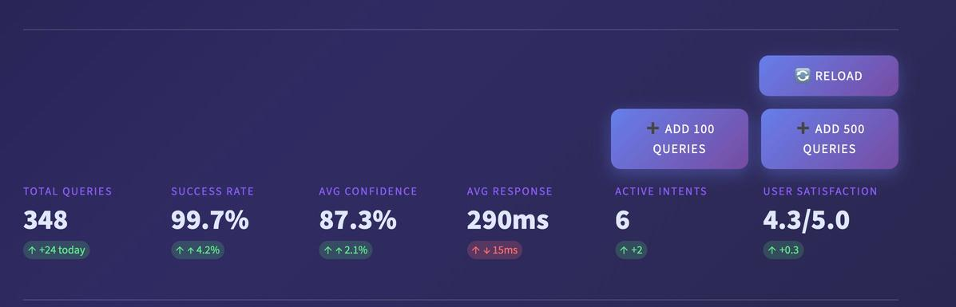
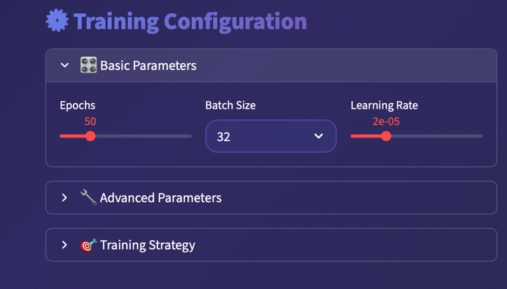
Admin Panel – Training Data & User Queries
Admin Dashboard Functionalities
Training Data Management:
View and edit intent training examples
Manage intents and entities dynamically
Trigger model retraining from UI
User Query Monitoring:
View real user queries
Display predicted intent and confidence score
Track successful vs failed responses
Impact:
Faster chatbot improvement
Continuous learning from real conversations

Slide 19
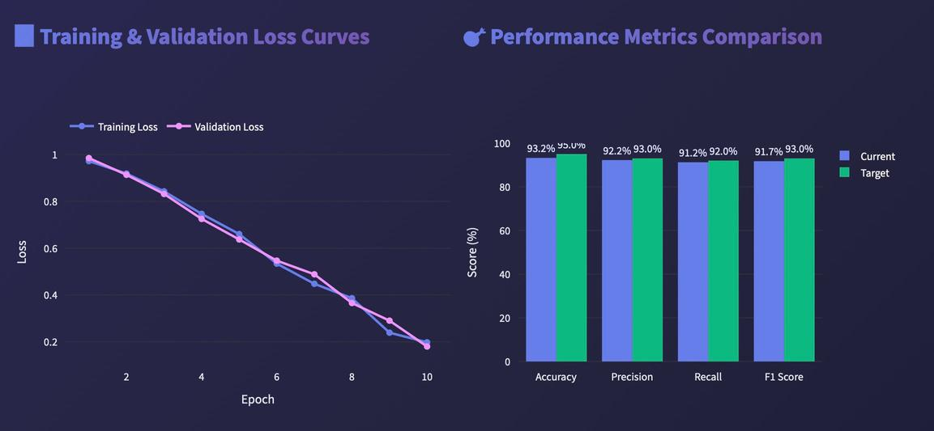
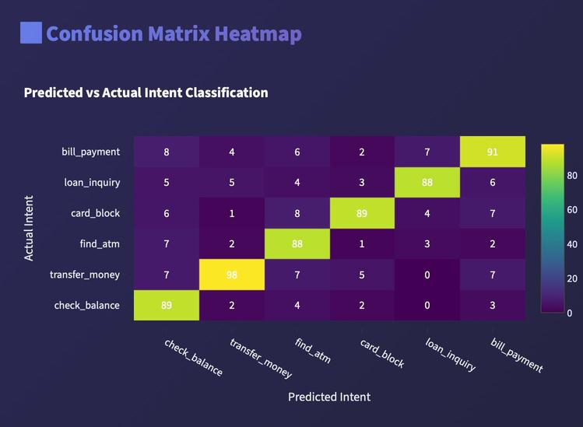
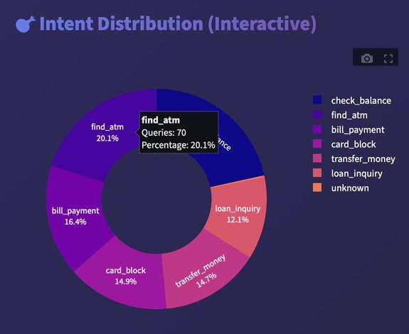
Knowledge Base & Analytics Dashboard
FAQs, Q&A, and Performance Insights
Knowledge Base Management:
Add, edit, and delete FAQs
Manage dynamic question–answer pairs
Instant updates reflected in chatbot responses
Analytics Dashboard:
Total queries count
Success rate and confidence trends
Intent-wise usage statistics
Performance metrics visualization

Slide 20
Thank You
Presented by B Satheesh

